Slide 1
Global CO2 Emissions Analysis
Key Trends and Insights (2000–2011)
Date: August 2026
Presenter: Mohamed Moussa

Slide 2
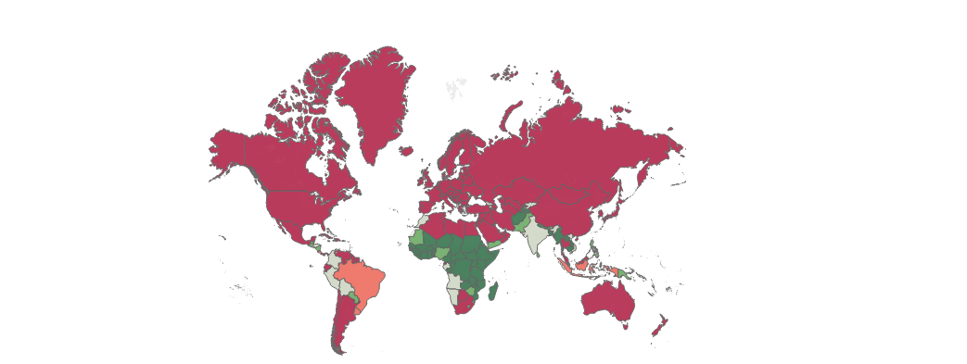
Geographic Distribution (Map)
Visualizes CO2 emissions per capita across different regions.
Highlights high-emission hubs vs. lower-emission developing areas.
Helps stakeholders pinpoint key regions requiring intervention.

Slide 3
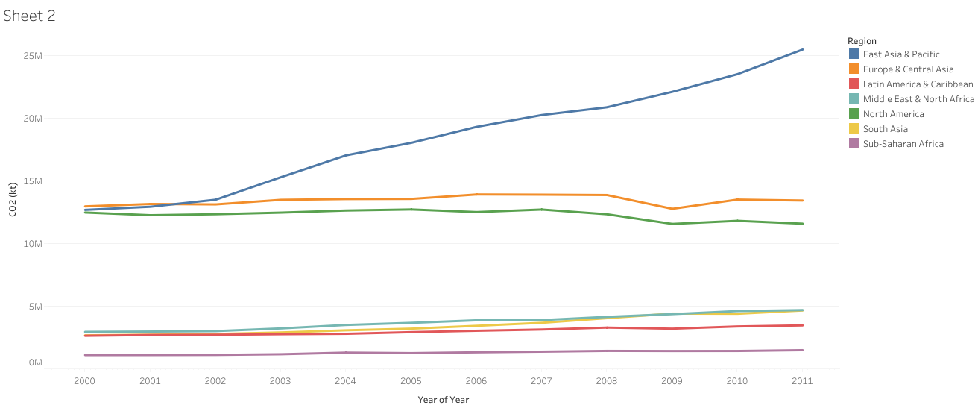
Regional Emission Trends (Line Chart)
Tracks total CO2 emissions across 7 global regions over a 10-year period.
Highlights a sharp upward trend in East Asia & Pacific (blue line), nearly doubling by 2011.
Shows high but plateaued emission levels in North America and Europe & Central Asia.
Illustrates lower and steady emission levels across other developing regions.

Slide 4
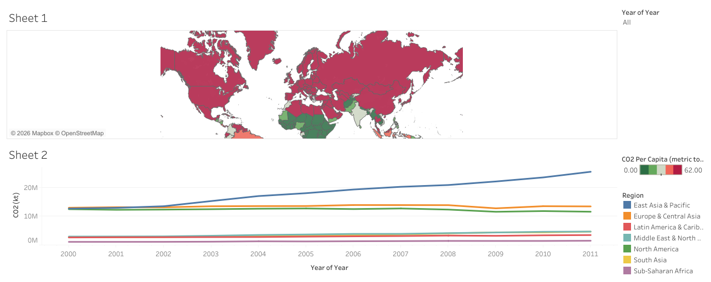
Interactive Dashboard Overview
Tracks overall emission growth trends from 2000 to 2011.
Interactive filters allow users to zero in on specific regions.
Connects geographical data with historical progress over time.

Slide 5
Final Takeaways
Data-driven insights are essential for setting global sustainability goals.
Visualizing regional differences supports targeted policy making.
Next Steps: Analyze correlation with economic metrics like GDP.
Thank You

